Slide 1

Chapter 32: Giving Your Best
By Group 2:
Nidhishree Sanam
Shwetha Reddy Reddymalli
Sai Gangadhar Veeramreddy
Sai Manoj Kalasani
Sravani Ravulaparthi

Slide 2

Characters in the story
Stanley – Product Manager
Kerry Drake – General Manager
Lesley – Stan’s colleague

Slide 3
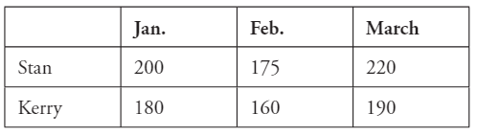
Story Recap
Expandrium is a leading telecommunications monitoring company that is a cash cow from its foundation.
Stan’s visibility in the company increased when he was appointed as Product Manager in The Company as part of his management training rotation. Stanley’s new responsibility is projecting the demand for Expandrium.
Stan was on edge because he was offered a “learning experience” - presenting the report directly to the GM.
When Stan first presented his report to Kerry, after all the wait, all he got in response was a question “Is this the best you can do?”
The Same thing happened a couple more times, Stan worked late night’s going over everything and rewriting half of it, only for Kerry to say, “Is this really the best you can do?”
Stan got stressed out and said “Yes, yes, that is the very best I can do!” to which Kerry responded, “In that case, I’ll read it.”
Kerry went ahead with Stan’s projection even though his gut tells him that the numbers are optimistic because Stan is closer to the data than anyone else and projections were still within an acceptable band of error.
Months later Stan understood that judgment can trump analysis as his prediction wasn’t too far off, but Kerry’s was right on target.
Stan didn’t change his model for the second quarter, he was just a little more conservative in interpreting what the model says.
What had happened? Kerry tested Stan, and Stan passed the test, earning his confidence.
Finally, Stan’s experience illustrated a broader principle: When an employee reports facts up the line, the facts do not speak for themselves. The messenger speaks for them - and most times, the message is shaped by what the messenger believes the boss wants to hear.

Slide 4

Managerial Lessons learned
Be confident in your work and have a clear vision about the progress.
Showing appreciation to employees will make them feel empowered which helps in producing high-quality work.
Proper guidelines will give high-quality results than complex directions and poorly outlines instructions.
Be Conservative when it comes to interpreting future demands with respect to the historical data

Slide 5
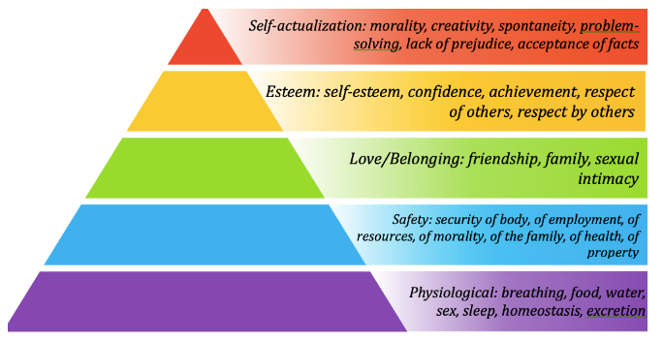
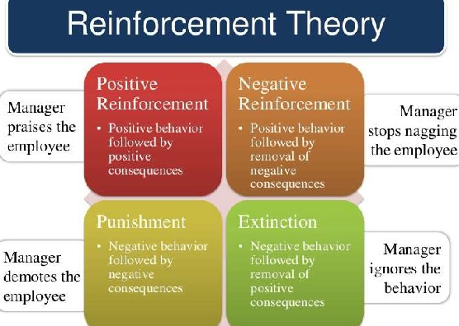
Theories
Motivational Theory:
Individual factors that determine the direction, intensity, and persistence of an individual's effort at work.
Direction: the decision made by a person after being provided with several options.
Intensity: The level of an individual's effort.
Persistence: It is the amount of time a person sticks with a particular action.
Reinforcement theory:
Using rewards, punishments, and extinction, the reinforcement theory of motivation tries to motivate employees to reinforce the desired employee experience and behavior.

Slide 6
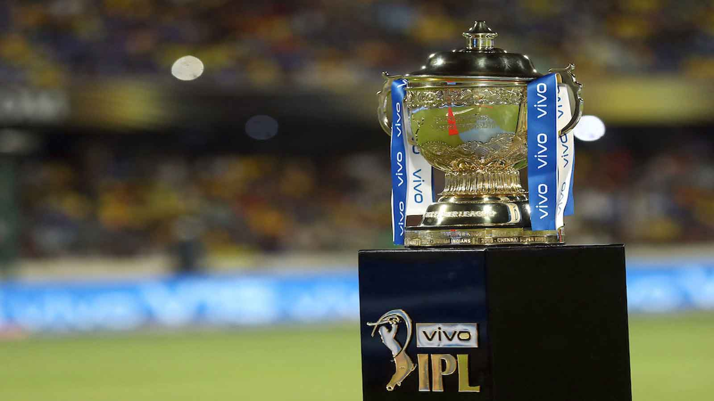
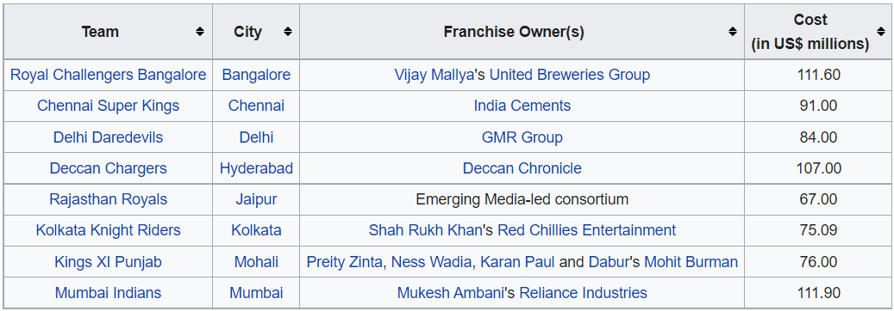

Additional Research
Rajasthan Royals won the first IPL trophy by spending the least amount of money at the players bidding auction.
Tech Mahindra BID $351 million at the exchange rate of 50 Rs/$ to get the shares of Satyam Computers. While Larsen and turbo (L&T) bid at Rs 46 per share and WL Ross bid for Rs 20/per share.
Annand Mahindra Stated that his prediction calculators have asked him to quote for 45 Rs/$ but with his experience, he has his quote for 50 Rs/$.

Slide 7

References:
The ropes to skip and the ropes to know_ studies in organizational theory and behavior-Chicago Business Press
Motivation & Reinforcement Theory- ENMG 652 Lecture.
https://www.westvalley.com/resources/employer-resources/top-five-simple-ways-to-bring-out-the-best-in-your-team
Tech Mahindra Wins Bid to Acquire Satyam Computers - Growing Up Aimi Series

